Slide 1

HOUSING PRICE PREDICTION
Presented by
k.ArunPrasad

Slide 2

ARTIFICIAL INTELLIGENCE-THE START OF OUR DREAM
2
2
0
1
Machine Learning- Predicting House prices with Regression

Slide 3
LET’S BEGIN NOW!
Houses are one of the necessary need of each and every person around the globe and therefore housing and real estate market is one of the markets which is one of the major contributors in the world’s economy. It is a very large market and there are various companies working in the domain. Data science comes as a very important tool to solve problems in the domain to help the companies increase their overall revenue, profits, improving their marketing strategies and focusing on changing trends in house sales and purchases. Predictive modelling, Market mix Modelling,recommendation systems are some of the machine learning techniques used for achieving the business goals for ousing companies. Our problem is related to one such housing company.

Slide 4
TABLE OF CONTENTS
1
Introduction
Before starting the presentation
2
Data Mining
predictive information from the analysis
3
EDA
Exploratory Data Analysis
4
Featured Engineering
domain knowledge to extract features
5
Building the model
using various machine learning algorithms
6
Conclusion
the last element of a research paper

Slide 5
INTRODUCTION

Slide 6
House prices increase every year . so there is a need for a system to predict house prices in the future.
House price prediction can help the developer determine the selling price of a house and can help the customer to arrange the right time to purchase a house.
There are three factors that influence the price of a house which include physical conditions concept and location.
This research aims to predict house prices based on A US based housing company named Surprise Housing which has decided to enter the Australian market.
In the present paper we discuss about the prediction of future housing prices that is generated by machine learning algorithm. For the selection of prediction methods we compare and explore various prediction methods.
We utilize Ada Boost regression as our model because of its adaptable and probabilistic methodology on model selection.
Our result exhibit that our approach of the issue need to be successful and has the ability to process predictions that would be comparative with other house cost prediction models.
6

Slide 7
Factors that affect House prices
LOCATION
PHYSICAL CONDITION
SALE TYPE & CONDITION
Location is an important factor in shaping the price of a house.
This is because the location determines the prevailing land price .
Physical conditions are properties possessed by a house that can be observed by human senses.
Sale Conditions are arrangements for a sale that are stated by the person or company selling the goods or properties which buyer must agree to.
for example, when payment must be made, how goods will be delivered, etc

Slide 8
3 KEY WORDS
1
2
3
BASIC STATISTICAL
ANALYSIS
EXPLORATORY DATA ANALYSIS
MACHINE LEARNING ALGORITHM
Statistical methods involved in carrying out a study include planning, designing, collecting data, analysing, drawing meaningful interpretation and reporting of the research findings. The statistical analysis gives meaning to the meaningless numbers, thereby breathing life into a lifeless data.
Exploratory data analysis (EDA) is used by data scientists to analyze and investigate data sets and summarize their main characteristics, often employing data visualization methods. It helps determine how best to manipulate data sources to get the answers you need, making it easier for data scientists to discover patterns, spot anomalies, test a hypothesis, or check assumptions.
Machine learning algorithms are the engines of machine learning, meaning it is the algorithms that turn a data set into a model. Which kind of algorithm works best (supervised, unsupervised, classification, regression, etc.) depends on the kind of problem you’re solving, the computing resources available, and the nature of the data.

Slide 9
Goals and Objectives
Goal
The purpose of the project is to document the process i went through to create my predictions for Housing sale price
Objective
We are required to model the price of houses with the available independent variables. This model will then be used
by the management to understand how exactly the prices vary with the variables.

Slide 10


Tools Used
Anaconda Navigator 1.9.6
Jupyter Notebook 5.7.4
Libraries Used
Analyzing : Numpy,Pandas
Visualization: : Matplotlib, Seaborn

Slide 11
Implementaion
1
Importing the necessary Libraries
A Python library is a reusable chunk of code that you may want to include in your programs/ projects. Compared to languages like C++ or C, a Python libraries do not pertain to any specific context in Python. Here, a 'library' loosely describes a collection of core modules.

Slide 12
2
3
Importing DataSet
Cleaning Dataset
A Dataset is the basic data container in Python. It serves as the primary form of data storage, but also as a common container for results returned by most algorithms. . In the simplest case, a dataset only contains data that is a matrix of numerical values.
Data cleansing or data cleaning is the process of detecting and correcting (or removing) corrupt or inaccurate records from a record set, table, or database and refers to identifying incomplete, incorrect, inaccurate or irrelevant parts of the data and then replacing, modifying, or deleting the dirty or coarse data.

Slide 13
4
EDA
Exploratory data analysis is an approach of analyzing data sets to summarize their main characteristics, often using statistical graphics and other data visualization methods. A statistical model can be used or not, but primarily EDA is for seeing what the data can tell us beyond the formal modeling or hypothesis testing task.
5
Data Labelling
Data Labelling is an indispensable stage of data pre-processing in supervised learning. Data labelling brings together data classification, moderation, transcription, processing, annotation and data tagging.

Slide 14
6
7
Feature Engineering
Feature engineering is the most important part of data analytic process. It deals with, selecting the features that are used in training and making predictions. In feature engineering the domain knowledge is used to find features in the dataset which are helpful in building machine learning model. It helps in understanding the dataset in terms of modeling
Building the Model
Regression analysis consists of a set of machine learning methods that allow us to predict a continuous outcome variable (y) based on the value of one or multiple predictor variables (x).
The Different Machine learning algorithm includes
Linear Regression
Lasso
Ridge
Decision Tree Regressor
Random Forest Regressor
Ada -Boost Regressor

Slide 15
Conclusion

Slide 16
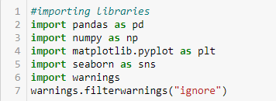
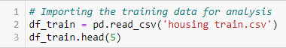
Importing Libraries
Loading Dataset

Slide 17
DATA MINING

Slide 18
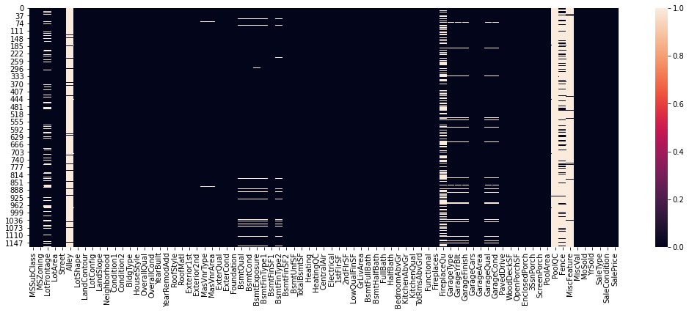
Finding Missing Values

Slide 19
we find missing values in few of the columns
It is very important to not loss too much data.But still filling the NaN values with mean or median or mode may result in high bias if we train ML algorithms especially when the column has high percentage of missing values.
Using mean value for replacing missing values may not create a great model and hence gets ruled out.
As a rule of thumb, when the data goes missing on 40 percent of the variable and above, dropping the variable should be considered.
so it is better to drop columns having high percentage of NaN values and fill the remaining missing columns with mean or mode values.

Slide 20
EXPLORATORY DATA ANALYSIS

Slide 21
Uni-variate Analysis
Univariate analysis is the simplest form of analyzing data. “Uni” means “one”, so in other words your data has only one variable. It doesn't deal with causes or relationships (unlike regression ) and it's major purpose is to describe
21

Slide 22
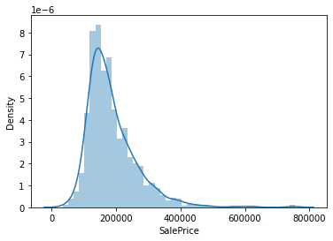
Target variable - “saleprice”
Basic description
Displacement plot

Slide 23
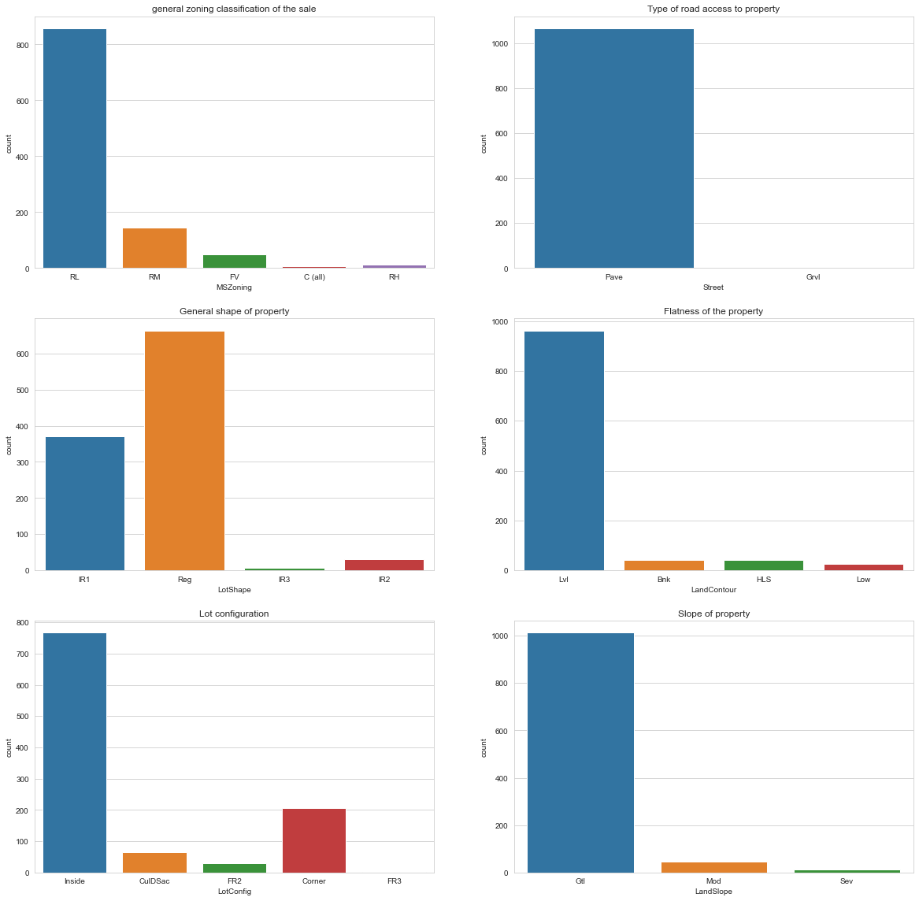
Categorical Features- Location
More number of houses were found with low residential density
There were around 1068 houses with paved road access whereas only 3 houses with Gravel road access
Large number of houses where seen to have regular shape and only very few with irregular shape
Regarding flatness of the property we notice houses around 950 in numbers were near flat/level followed by houses with quick and significant rise from street grade to building.
Houses with Inside lot configuration where found high in numbers
Mostly houses where found in Gentle slopes,followed by Moderate and severe slope

Slide 24
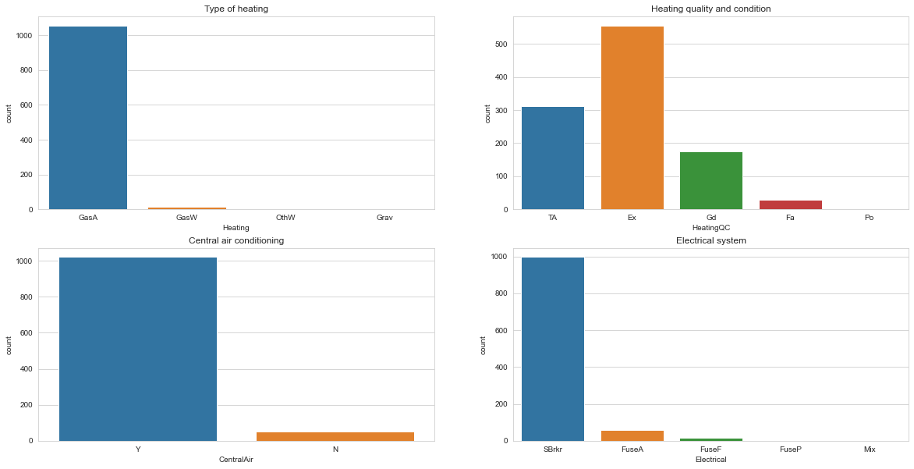
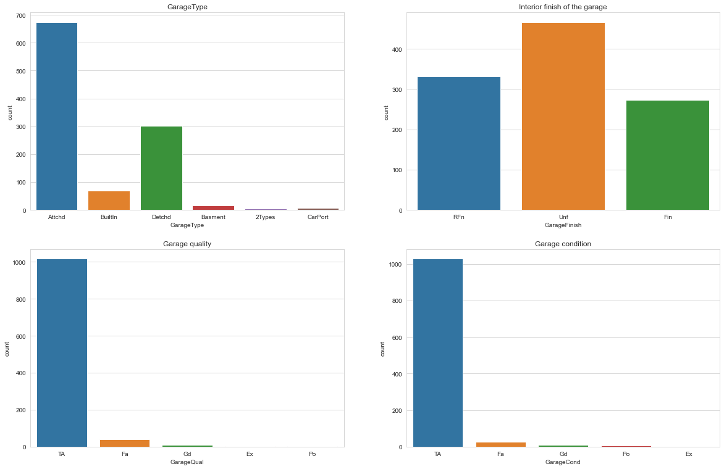
Categorical Features-Physical Condition
Heating,Electical and Air conditioning system
Garage
Gas forced warm air furnace heating sysytem is found in most of the houses
There were more number of houses with excellent Heating quality and condition
Almost all houses is fitted with Central air conditioning system
Around 1000 houses is fitted with Standard Circuit Breakers & Romex as the electrical system
We can see most of the houses were attached with garage
Regarding the interior finish of the garage, we can see only 280 garages were in finished condition. Around 480 garages were still unfinished,followed by roughly finished garages(around 320 in numbers).
Many garages were seen with average/typical garage quality
similarly we can see the condition of most of the garages were in average/typical condition .

Slide 25
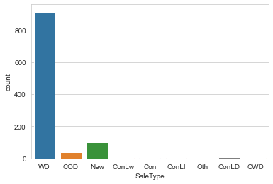
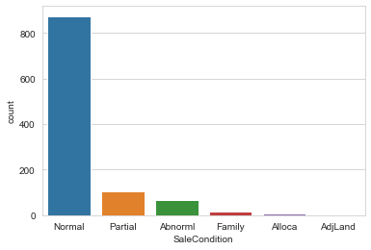
Categorical Features- Sales Type and condition
Warranty deed acts as a guarantee to the buyer where the seller has all the right to sell the property, and also the property is free from debts and other liabilities,despite the warranty deed. The graph shows most of the properties where Warranty Deed in Conventional way
Regarding sales condition,Normal condition where high when considering others

Slide 26
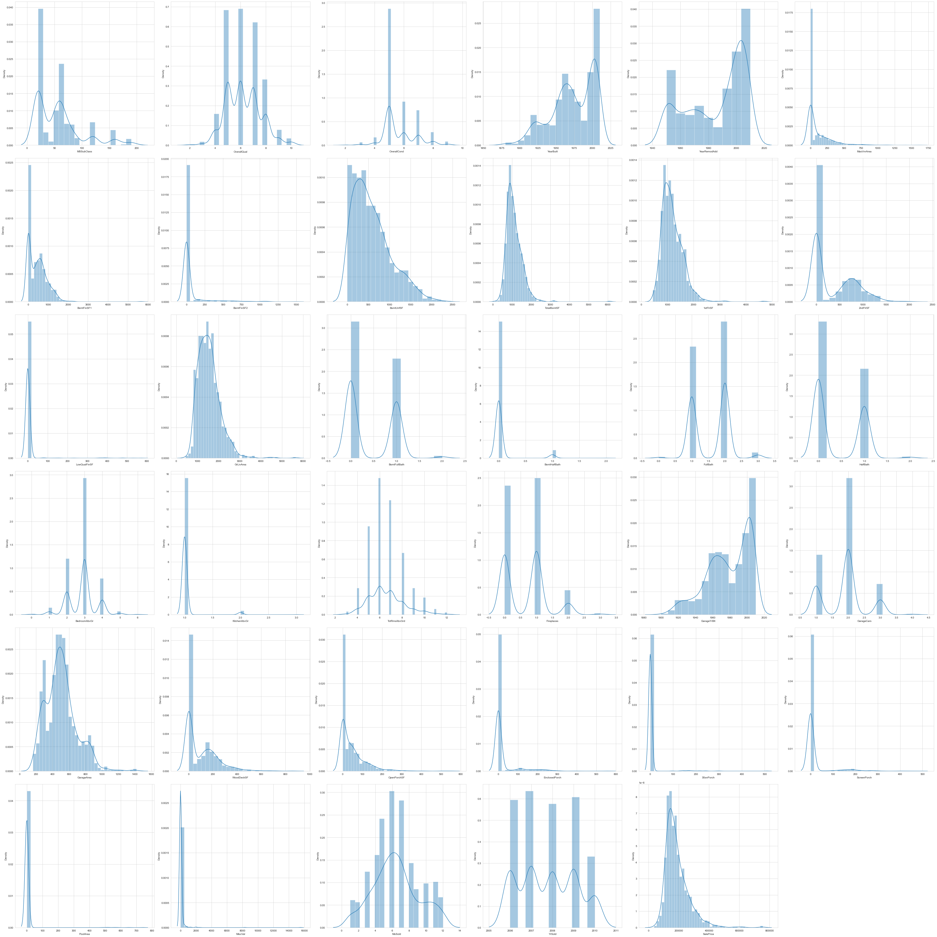
Numerical Features

Slide 27
Bi-variate Analysis
Bivariate analysis is one of the simplest forms of quantitative analysis. It involves the analysis of two variables, for the purpose of determining the empirical relationship between them.
27

Slide 28
Scatterplot b/w Target varaible and other variables
From the scatter plot we understand that , with increase in each square feet the sale price of the property increases.

Slide 29
CATEGORICAL ENCODING

Slide 30

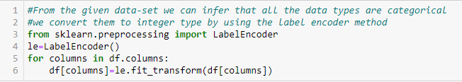
LABEL ENCODER
01
Label Encoding refers to converting the labels into numeric form so as to convert it into the machine-readable form
Machine learning algorithms can then decide in a better way on how those labels must be operated
02
03
It is an important pre-processing step for the structured dataset in supervised learning.
04
Once the Encoding is done we proceed with Feature Engineering.

Slide 31
FEATURED ENGINEERING

Slide 32
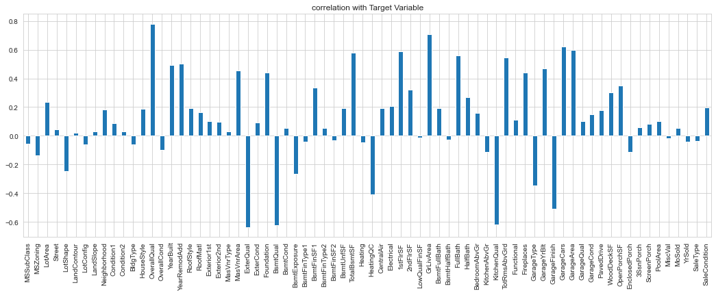
Correlation

Slide 33
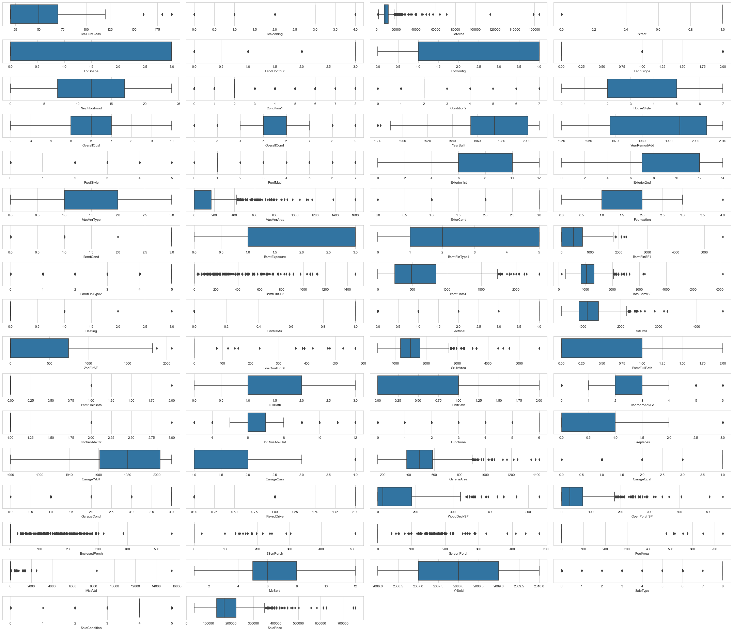
Outliers

Slide 34
BUILDING THE MODEL

Slide 35
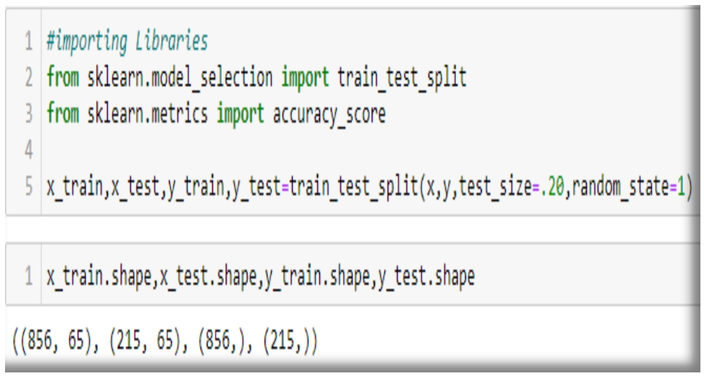
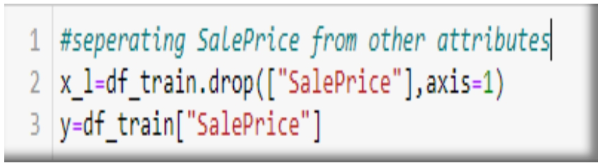
Separating features from the target variable
Using train_test_split
35

Slide 36
Importing Model Libraries
Model Algorithm

Slide 37
Accuracy
ADABOOST REGRESSOR
LINEAR REGRESSION
Training score - 98.62
r2 score - 84.82
Training score - 81.89
r2 score - 74.79
RANDOM FOREST REGRESSOR
KNN
Training score - 97.44
r2 score - 83..22
Training score - 77..45
r2 score - 73.94
RIDGE
LASSO
Training score - 81.89
r2 score - 74.81
Training score - 81.89
r2 score - 74.78

Slide 38
MODEL EVALUATION
Mean Absolute Error (MAE)
Mean absolute percentage error (MAPE)
Root Mean Square Error (RMSE)

Slide 39
MODEL | MAE | MAPE | RMSE
Linear Regression | 23190.56 | 1751 | 41845.17
KNN | 24196.47 | 1809 | 42538.72
Lasso | 23182 | 1751 | 41848.44
Ridge | 23171.44 | 1749 | 41821.99
ElasticNet | 22447.08 | 1741 | 41729.54
Random Forest | 17512.76 | 1164 | 132.33
AdaBoost | 16779.58 | 1054 | 129.53

Slide 40
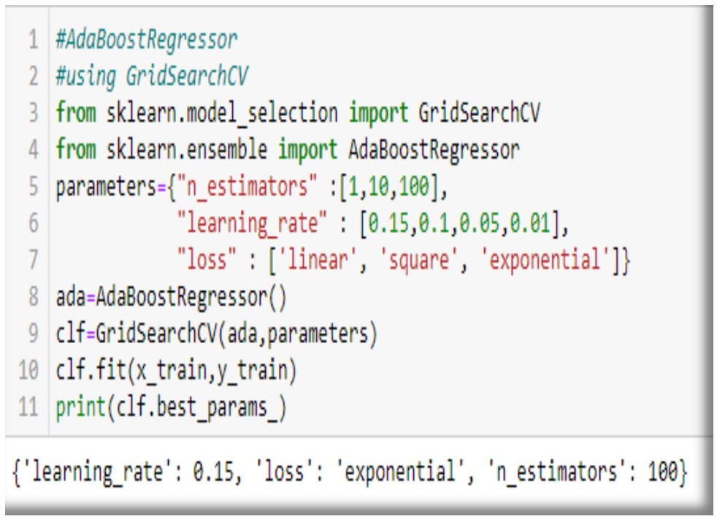
HYPER PARAMETER TUNING GRIDSEARCH CV

Slide 41
Hyperparameters are crucial as they control the overall behavior of a machine learning model.
The ultimate goal is to find an optimal combination of hyperparameters that minimizes a predefined loss function to give better results. Here we first find the best parameters for the Adaboost Regressor Model and indulge it to the model to improve our predicting accuracy.
There are several ways for finding the parameters, here we use the most powerful and most commonly used method named GridSearchCV.

Slide 42
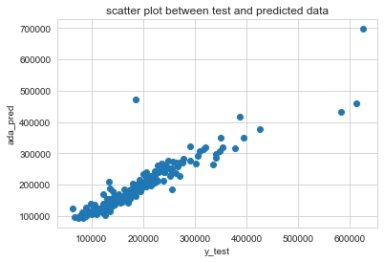
Futher Evaluation Scatter Plot b/w Test-data and Predicted-data

Slide 43
RESULT
AdaBoost made the best performance overall when both R2 and RMSE scores are taking into consideration.
It has achieved the best performance due to its L1 norm regularisation for assigning zero weights to the insignificant features.

Slide 44
Saving Train Dataset

Slide 45
PREDICTING SALE PRICE FROM TEST DATASET
Loading Test Dataset
Predicting over Test Data

Slide 46
OUTPUT

Slide 47
CONCLUSION

Slide 48
The results answer the research questions as follows:
Question 1 – Which machine learning algorithm performs better and has the most accurate result in house price prediction? And why?
AdaBoost made the best performance overall when both R2 and RMSE scores are taking into consideration. It has achieved the best performance due to its L1 norm regularisation for assigning zero weights to the insignificant features.
Question 2 – What are the factors that have affected house prices in ?
"BldgType", 'ExterQual', "BsmtQual", "HeatingQC", "KitchenQual", "GarageType","Garage Finish" has a weak correlation with the house prices. Which means there are lower likelihood relationships between these factors and sale price. However, when these factors increase the house price decrease.

Slide 49
THANK YOU FOR WATCHING!
ANY QUESTIONS?

